Slide 1
Teacher Preparation, Licensure, & Retention
Dr. Thomas R. Tomberlin
Senior Director, Office of Educator Preparation, Licensure, and Performance
June 22, 2026

Slide 2
Presentation Overview
Key Context
Trends in Teacher Pipeline Data
Outcomes & Analyses
Questions

Slide 3
Key Context

Slide 4
Educator Preparation Programs (EPPs)
Public – UNC System (15)
Private – NC private or independent colleges or universities (31)
Community Colleges – NC Community College System (28)
Other – Not affiliated with a NC public university, private college or university, or community college (13)

Slide 5
Definition of Teacher
Pursuant to NC General Statute 115C-325(a)(6),
a teacher is defined as one who:
  Maintains a current license issued by the State Board of Education
  Teaches, directly supervises teaching, or is paid as a classroom teacher (as opposed to instructional support or administrator)
  Holds a full-time, permanent position
  Note: In keeping with current law, only 50% of charter and laboratory school educators are required to be licensed.

Slide 6
Teacher Licensure Process
Traditional Pathway
  Admission to an IHE with an approved EPP
  Admission to EPP with GPA of 2.7 or greater
  Completion of bachelor’s degree
  Completion of EPP
  Clinical experience
  3-year term, non-renewable
  Complete EPP program
  Pass all required examinations
  3 years of teaching experience
  5-year term, renewable with CEUs
Matriculation to Institution of Higher Education (IHE)
Initial Professional License (IPL)
Continuing Professional License (CPL)
Alternative Pathway
  Bachelor’s degree
  Less than 18 semester hours in content area
  Employed in NC PSU
  1-year term, non-renewable
  Bachelor’s degree
  18 semester hours in content area
  Employed in NC PSU
  1-year term, non-renewable
  Bachelor’s degree
  24 semester hours in content area or pass content exam
  Employed in NC PSU
  Admission to approved EPP
  1-year term, renewable twice.
Permit to Teach (PtT)
Emergency License (EL)
Residency License (RL)

Slide 7
Teacher Effectiveness
The Educator Value-Added Assessment System (EVAAS) is the state’s official growth model, and it is used as the measure of teacher effectiveness for quantitative analyses. EVAAS is measured annually and only for those teachers who teach a state-tested subject (e.g., End of Grade, End of Course, K-2 Reading, and Career-Technical Education). Approximately 40% of the teaching force in the State receives an EVAAS score.
Does Not Meet Expected Growth
Meets Expected Growth
Exceeds Expected Growth​
Teachers demonstrate growth with students that is significantly lower than the average teacher in that grade and subject.
Teacher demonstrates growth with students that is consistent with the growth of the average teacher in that grade and subject.
Teacher demonstrates growth with students that is significantly higher than the average teacher in that grade and subject.

Slide 8
Teacher Effectiveness
Expressed in effect size
Standardized measure of magnitude
Compares program or group effects
Education researchers generally use interpretations for effect size
±<0.05 Very Small Impact
±0.05-0.20 Moderate*
±≥ 0.20 Large**
*typical meaningful impact
**unusual, high impact intervention

Slide 9
Active Licenses, Areas, & Employment
 | Number of Unique, Active NC Licenses | Number of Unique, Active Licenses Employed | Percentage Employed
 | 174,590 | 120,226 | 68.9%
Subject Areas* | *Teachers may hold multiple subject areas on a single license.
Elementary | 76,229 | 59,981 | 78.7%
English/Language Arts | 37,131 | 10,830 | 29.2%
Math | 23,096 | 8,111 | 35.1%
Science | 18,137 | 6,154 | 33.9%
Social Studies | 24,494 | 7,246 | 29.6%
Exceptional Children | 40,412 | 11,085 | 27.4%
Career and Technical Ed. | 16,989 | 7,360 | 43.3%
Arts | 9,669 | 7,174 | 74.2%
Health/Physical Ed. | 12,536 | 7,104 | 56.7%

Slide 10
Trends in Teacher Pipeline Data

Slide 11
License Routes of NC Newly Hired Teachers
License Routes
Year | NC EPP |  | Out-of-State | CTE | International | Other
 | Traditional Pathway | Residency Pathway
2017-18 | 33.11% | 33.31% | 25.79% | 2.05% | 5.08% | 0.66%
2018-19 | 30.84% | 35.74% | 25.75% | 1.97% | 5.08% | 0.63%
2019-20 | 32.73% | 31.6% | 26.98% | 2.04% | 6.18% | 0.46%
2020-21 | 37.22% | 29.44% | 28.77% | 2.23% | 2.02% | 0.33%
2021-22 | 33.82% | 31.83% | 26.92% | 1.89% | 5.11% | 0.44%
2022-23 | 29.66% | 34.57% | 23.70% | 2.06% | 9.72% | 0.30%
2023-24 | 29.34% | 34.69% | 24.28% | 2.44% | 8.96% | 0.30%
2024-25 | 27.23% | 32.42% | 23.99% | 2.54% | 13.44% | 0.39%

Slide 12
Vacancy Rates Over Time & By Type
Reporting Year | State Vacancy Rate
2021-2022 | 5.9%
2022-2023 | 6.4%
2023-2024 | 7.6%
2024-2025 | 7.4%
Average | 6.8%
Employee Description | Percentage of All Positions (2025) | Number
Temporary or Provisionally Licensed | 5.0% | 4,566
Rehired Retirees | 0.2% | 160
Long-Term Substitutes | 1.0% | 905
Unfilled Positions | 1.2% | 1,090
Total Vacant Positions | 7.4% | 6,721

Slide 13
Teacher Workforce:
Years of Experience & Attrition (2024-2025)

Slide 14
Outcomes and Analyses: Educator Preparation

Slide 15
EPP Enrollment & Completion

Slide 16
Data from the EPP Dashboard (2019-2025)
Measure | Range of Data
Licensure Exam Pass Rates (Best Attempt) | 52.9% - 98.5%
Percentage of Completers Converting to a Continuing Professional License (CPL) | 33.3% - 100%
Percentage of Completers Who Gain Employment in NC Public Schools (within 3 years) | 22.8% - 100%
Percentage of Completers Who Teach Two or More Years | 60% - 100%
Percentage of Completers Indicating Well or Very-Well Prepared on Recent Graduate Survey | 11% - 100%
Percentage of Principals Indicating Completer of Comparable Effectiveness, More Effective, or Much More Effective than Other First-Year Teachers | 79% - 100%
Percentage of Completers Meeting or Exceeding Growth on EVAAS (2025) | 67% - >95%
Completers Rated Proficient or Above on NC Educator Evaluation System | 71% - >95%
Workbook: NCDPI EPP Dashboard Home

Slide 17
Outcomes & Analyses:
Licensure Pathways

Slide 18
Early-Career Effectiveness & Licensure Pathway
Effect Size Interpretations
±<0.05 Very Small Impact
±0.05-0.20 Moderate*
±≥ 0.20 Large**
*typical meaningful impact​
**unusual, high impact intervention​

Slide 19
Traditional vs. Residency Licensed Teachers:
Post-Program Completion
Effect Size Interpretations
±<0.05 Very Small Impact
±0.05-0.20 Moderate*
±≥ 0.20 Large**
*typical meaningful impact​​
**unusual, high impact intervention​

Slide 20
Early-Career Attrition by Licensure Pathway
no longer
held license

Slide 21
Beginning Teacher Support & Educator Attrition

Slide 22
Conversion to Continuing Professional License (CPL)
Converted to CPL by Y5 ​

Slide 23
Outcomes & Analyses:
Vacancy

Slide 24
Workforce Projection: Trends in Vacancy Rates (2022-2025)

Slide 25
Outcomes & Analyses:
Teachers' Perceptions &
Working Conditions

Slide 26
Teachers’ Perceptions of Preparation & Support (2025-2026) 2,850 Surveys administered – 62% response rate
Quality
Highest Ranked Areas | Average Score (1-5) | Lowest Ranked Areas | Average Score (1-5)
Align to State Standards | 4.34 | Teach AG students | 3.65
Self-Assess and Reflect | 4.27 | Teach EL students | 3.69
Positive Relationships with Students | 4.27 | Work with parents/families | 3.76
Teach within Discipline | 4.23 | Maintain discipline | 3.80
Opportunity/Influence
Highest Ranked Areas | Average Score (1-5) | Lowest Ranked Areas | Average Score (1-5)
Success Due to Mentor | 5.00 | Co-Teaching with Mentor | 1.69
Strong Professional Relationship | 4.32 | Observing Mentor Teaching | 2.71
Individualized Support | 4.21 | Planning Instruction | 3.28
Implementation of Feedback | 4.07 | Unit and lesson planning | 3.32
Reflecting on Practice with Mentor | 3.85 | Pedagogical Strategies | 3.39

Slide 27
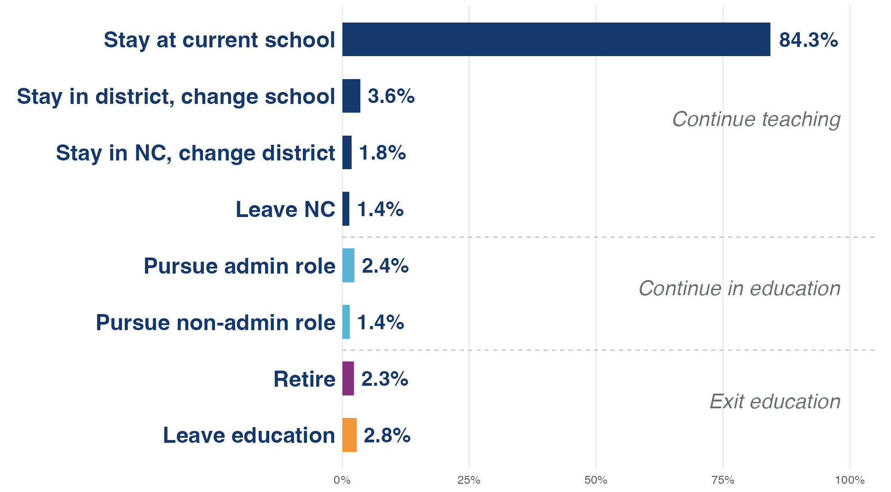

Teacher Working Conditions &
Teachers’ Professional Decisions
Data from 2026 Teacher Working Conditions survey. (102,640 responses - 90.54% response rate)
Percent Positive Agreement (Agree or Strongly Agree)

Slide 28
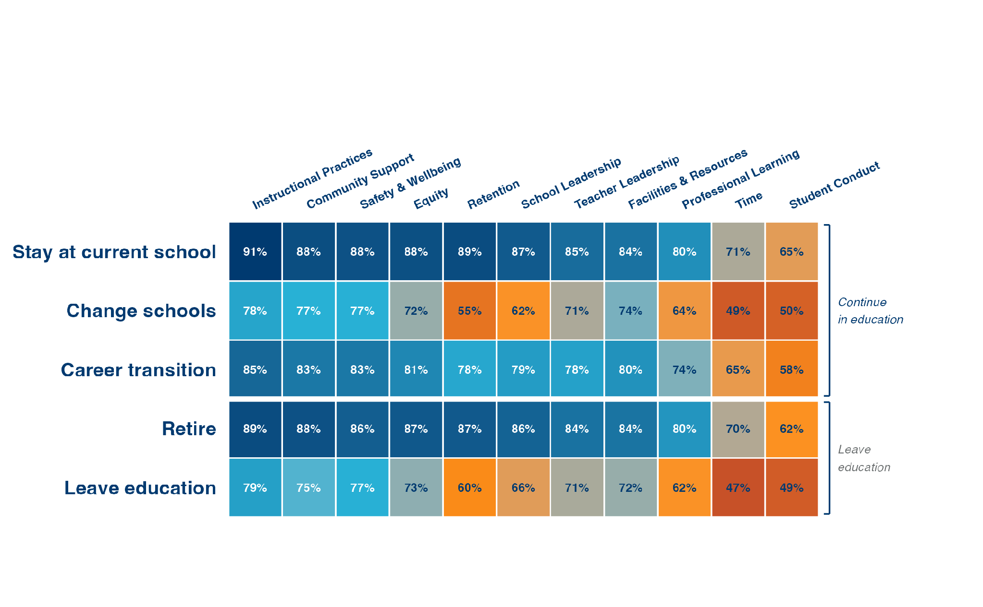
Teacher Working Conditions &
Teachers’ Professional Decisions
Percent Positive Agreement (Agree or Strongly Agree)

Slide 29
Key Takeaways
Preparation matters
Support in early career matters
Experience matters
Combination of preparation & experience matters more than either individually
North Carolina State Board of Education Licensure Task Force will be exploring ways to improve the licensure process

Slide 30
Questions?
Dr. Thomas R. Tomberlin, thomas.tomberlin@dpi.nc.gov

