Slide 1
North Carolina’s
Economic Recovery & Future
September 2023
Jeff DeBellis
Director of Economic & Policy Analysis
NC Department of Commerce, LEAD

Slide 2
Labor & Economic Analysis Division
Labor Market Data Production
Data Collection & Production (incl. Unemployment Rates)
Industry Establishments & Jobs
Big Data Analysis & Research
Big Data Analysis
Economic & Policy Analysis
Publications & Websites
Occupational Employment & Wages
Online & Print Publications
Dashboards (Analytics.NCcommerce.com)
Data Access Tools (D4.NCcommerce.com,NCcareers)
Program Evaluation
Common Follow-up System (NCTOWER.com)
Employment Projections
Star Jobs
LMI Tools & Publications
Econ Development Reports (e.g. County Tier Designations)

Slide 3
Agenda
Big Picture of the Labor Market
Job recovery & growth
Labor force
Tight labor market
Look Forward
Workforce needs
People, education, & skills
Growing industries & jobs
Staying Informed

Slide 4
Employment fully back from Covid
North Carolina
United States
Source: NC Department of Commerce, LEAD CES seasonally adjusted

Slide 5
NC’s Job Recovery from Recessions
Source: NC Department of Commerce, LEAD CES seasonally adjusted

Slide 6
Job Growth Greatest in Major Metros Feb ‘20-Jul ‘23
6.5%
NC average
Source: NC Department of Commerce, LEAD CES seasonally adjusted

Slide 7
Job Growth Greatest in Major Metros Feb ‘20-Jul ‘23
6.5%
NC average
Source: NC Department of Commerce, LEAD CES seasonally adjusted

Slide 8
Job Growth in Most Industries Feb ‘20-Jul ‘23
6.5%
NC average
Source: NC Department of Commerce, LEAD CES seasonally adjusted

Slide 9
Job Growth in Most Industries Feb ‘20-Jul ‘23
Professional & technical services
Finance & insurance
Information
6.5%
NC average
Source: NC Department of Commerce, LEAD CES seasonally adjusted

Slide 10
Job Growth in Most Industries Feb ‘20-Jul ‘23
Transportation & warehousing
Educational services
6.5%
NC average
Source: NC Department of Commerce, LEAD CES seasonally adjusted

Slide 11
Job Growth in Most Industries Feb ‘20-Jul ‘23
6.5%
NC average
Accommodation & food services
Manufacturing
Government
Management of companies
Source: NC Department of Commerce, LEAD CES seasonally adjusted

Slide 12
Room to Add More? Job openings exploded post-Covid
-2%
32% more
job openings
Jun ‘23 vs Jun ’19
32%
…but slowing.
June openings
down 2% from ‘22
Source: NC Department of Commerce, LEAD analysis of Lightcast’s HWOL data, seasonally adjusted

Slide 13
Very Few Unemployed or Looking
Fewest # of Unemployed since Sept ‘00
3.3% Unemployment
Rate
Last lower in May ‘99
Source: NC Department of Commerce, LEAD LAUS, seasonally adjusted

Slide 14
Relatively Low Unemployment Rates Across NC July 2023
2.7%
6.7%
Every County’s UR lower than Jul ‘19
Source: NC Department of Commerce, LEAD LAUS not seasonally adjusted

Slide 15
Tightest Labor Market in 20+ Years
0.9
jobseekers
for every 1 opening
Source: NC Department of Commerce, LEAD analysis of Lightcast’s HWOL data, seasonally adjusted

Slide 16
Labor Force Participation?
NC down -0.5 pts Feb ’20-Jul ‘23
US down -0.7 pts
Participation rate decline due mostly to demographics
Likely to continue to fall as our population ages
Nationally, age 25-54 participation highest in 20 years
Source: NC Department of Commerce, LEAD LAUS, seasonally adjusted, BLS/US Census CPS

Slide 17
NC Weekly Wage Growth Month of July, 2009-2023
Wages grew 25%
Jul ’19-Jul ‘23
…but only 5%
after inflation
5%
Inflation Adjusted
5%
25%
Wages grew 25%
Jul ’09-Jul ‘19
25%
…and only 5%
after inflation
Source: NC Department of Commerce, LEAD LAUS, seasonally adjusted

Slide 18
Where the Labor Market Stands

Slide 19
In Short…
Covid Recession is over
Job growth, inflation, and wages are slowing
Industry employment still changing, but structural changes (?)
Lack of workers likely to last while economy is growing
Natural population growth slowing
31 counties projected to lose population overall, 2020-’30
88% of NC’s projected growth to come from net migration
Source: NC State Demographer

Slide 20
Looking Forward Where are the Workers & Jobs Going to Come From?

Slide 21
From Anywhere…

Slide 22
More working at home, growth by MSA 2019 to 2021
Source: US Census Bureau American Community Survey

Slide 23
More working at home, growth by MSA 2019 to 2021
Source: US Census Bureau American Community Survey

Slide 24
More working at home, growth by MSA 2019 to 2021
Source: US Census Bureau American Community Survey

Slide 25
More working at home, growth by MSA 2019 to 2021
18.8%
Worked at Home in North Carolina, 2021
Source: US Census Bureau American Community Survey

Slide 26
From the Overlooked…

Slide 27
Greater Necessity & Opportunities to Grow the Employment Pool
Black workers
6.8% unemployed, more than 2x higher than other races, 2022
Disconnected Youth
1 in 8 (12%) 16–24 year-olds not working or in school, 2021
Disabled
11.3% unemployed, 2021
Ex-offenders
48% employed 1-year post-release, 2020
Source: BLS/US Census Bureau CPS , US Census Bureau ACS, NC Department of Commerce CFS

Slide 28
From Technology…

Slide 29
Technology as a labor solution? Share of occupations at each ed level with high automation potential
Automation are changing jobs and skill needs
40% of North Carolina jobs have high share of automatable tasks
Source: NC Department of Commerce, LEAD analysis of LMI Institute’s Automation Exposure Index

Slide 30
Looking Forward What about worker quality, education & skills?

Slide 31
Education…

Slide 32
Education still matters NC unemployment rate by education level, 2022
Source: BLS/US Census Bureau CPS

Slide 33
Education still matters NC unemployment rate by education level, in 2012
Source: US Census Bureau ACS

Slide 34
Enduring skills…

Slide 35
Hiring Troubles Where NC employers had the most difficulty hiring entry-level workers, 2021
Too Few Applicants
Employability Skills
Low Pay
Soft Skills
Experience
Education
Technical Skills
Criminal Record
Childcare
Commuting Distance
Transportation
Drugs
Source: NC Department of Commerce, LEAD 2022 Employer Needs Survey

Slide 36
Hiring Troubles Where NC employers had the most difficulty hiring entry-level workers, 2021
Too Few Applicants
Employability Skills
Low Pay
Soft Skills
Experience
Education
Technical Skills
Criminal Record
Childcare
Commuting Distance
Transportation
Drugs
Source: NC Department of Commerce, LEAD 2022 Employer Needs Survey

Slide 37
Hiring Troubles Where NC employers had the most difficulty hiring entry-level workers, 2021
Too Few Applicants
Employability Skills
Low Pay
Soft Skills
Experience
Education
Technical Skills
Criminal Record
Childcare
Commuting Distance
Transportation
Drugs
Source: NC Department of Commerce, LEAD 2022 Employer Needs Survey

Slide 38
Hiring Troubles Where NC employers had the most difficulty hiring entry-level workers, 2021
Too Few Applicants
Employability Skills
Low Pay
Soft Skills
Experience
Education
Technical Skills
Criminal Record
Childcare
Commuting Distance
Transportation
Drugs
Source: NC Department of Commerce, LEAD 2022 Employer Needs Survey

Slide 39
Looking Forward What about the jobs?

Slide 40
Employment Projections, 2021-2030
More Ed Needed for Future Jobs
Occupational growth rates for jobs by min ed required

Slide 41
Employment Projections, 2021-2030
But Many Jobs Still Req Little Ed
Total number of net new jobs projected

Slide 42
Industry Needs for Jobs Projected average annual NC job growth, 2021-2030
Source: NC Department of Commerce, LEAD 2021-2030 Industry Projections

Slide 43
Most Projected Net New Jobs occupation groups projections 2021-2030
Food Preparation & Serving Related
Transportation & Material Moving
Business & Financial Operations
Management
Healthcare Practitioners & Technical
Computer & Mathematical
Healthcare Support
Educational Instruction & Library
Installation, Maintenance, & Repair
Construction & Extraction
Source: NC Department of Commerce, LEAD 2021-2030 Occupational Projections

Slide 44
Most Projected Net New Jobs occupation groups projections 2021-2030
Food Preparation & Serving Related
Transportation & Material Moving
Business & Financial Operations
Management
Healthcare Practitioners & Technical
Computer & Mathematical
Healthcare Support
Educational Instruction & Library
Installation, Maintenance, & Repair
Construction & Extraction
Source: NC Department of Commerce, LEAD 2021-2030 Occupational Projections

Slide 45
Fastest Growing Occupations Requiring Some Education < Master’s, 2021-30
Solar Photovoltaic Installers | High school diploma or equivalent
Wind Turbine Service Technicians | Postsecondary nondegree award
Data Scientists | Bachelor's degree
Logisticians | Bachelor's degree
Information Security Analysts | Bachelor's degree
Web Developers | Bachelor's degree
Animal Caretakers | High school diploma or equivalent
Medical & Health Services Mgrs | Bachelor's degree
Choreographers | High school diploma or equivalent
CNC Tool Programmers | Postsecondary nondegree award
Software Developers | Bachelor's degree
Occupational Therapy Assistants | Associate's degree
Physical Therapist Assistants | Associate's degree
Source: NC Department of Commerce, LEAD 2021-2030 Occupational Projections

Slide 46
Fastest Growing Occupations Requiring Some Education < Master’s, 2021-30
Solar Photovoltaic Installers | High school diploma or equivalent
Wind Turbine Service Technicians | Postsecondary nondegree award
Data Scientists | Bachelor's degree
Logisticians | Bachelor's degree
Information Security Analysts | Bachelor's degree
Web Developers | Bachelor's degree
Animal Caretakers | High school diploma or equivalent
Medical & Health Services Mgrs | Bachelor's degree
Choreographers | High school diploma or equivalent
CNC Tool Programmers | Postsecondary nondegree award
Software Developers | Bachelor's degree
Occupational Therapy Assistants | Associate's degree
Physical Therapist Assistants | Associate's degree
Source: NC Department of Commerce, LEAD 2021-2030 Occupational Projections

Slide 47
Fastest Growing Occupations Requiring Some Education < Master’s, 2021-30
Solar Photovoltaic Installers | High school diploma or equivalent
Wind Turbine Service Technicians | Postsecondary nondegree award
Data Scientists | Bachelor's degree
Logisticians | Bachelor's degree
Information Security Analysts | Bachelor's degree
Web Developers | Bachelor's degree
Animal Caretakers | High school diploma or equivalent
Medical & Health Services Mgrs | Bachelor's degree
Choreographers | High school diploma or equivalent
CNC Tool Programmers | Postsecondary nondegree award
Software Developers | Bachelor's degree
Occupational Therapy Assistants | Associate's degree
Physical Therapist Assistants | Associate's degree
Source: NC Department of Commerce, LEAD 2021-2030 Occupational Projections

Slide 48
Fastest Growing Occupations Requiring Some Education < Master’s, 2021-30
Solar Photovoltaic Installers | High school diploma or equivalent
Wind Turbine Service Technicians | Postsecondary nondegree award
Data Scientists | Bachelor's degree
Logisticians | Bachelor's degree
Information Security Analysts | Bachelor's degree
Web Developers | Bachelor's degree
Animal Caretakers | High school diploma or equivalent
Medical & Health Services Mgrs | Bachelor's degree
Choreographers | High school diploma or equivalent
CNC Tool Programmers | Postsecondary nondegree award
Software Developers | Bachelor's degree
Occupational Therapy Assistants | Associate's degree
Physical Therapist Assistants | Associate's degree
Source: NC Department of Commerce, LEAD 2021-2030 Occupational Projections

Slide 49
Fastest Growing Occupations Requiring Some Education < Master’s, 2021-30
Solar Photovoltaic Installers | High school diploma or equivalent
Wind Turbine Service Technicians | Postsecondary nondegree award
Data Scientists | Bachelor's degree
Logisticians | Bachelor's degree
Information Security Analysts | Bachelor's degree
Web Developers | Bachelor's degree
Animal Caretakers | High school diploma or equivalent
Medical & Health Services Mgrs | Bachelor's degree
Choreographers | High school diploma or equivalent
CNC Tool Programmers | Postsecondary nondegree award
Software Developers | Bachelor's degree
Occupational Therapy Assistants | Associate's degree
Physical Therapist Assistants | Associate's degree
Source: NC Department of Commerce, LEAD 2021-2030 Occupational Projections

Slide 50
Making Labor Market Information More Accessible

Slide 52
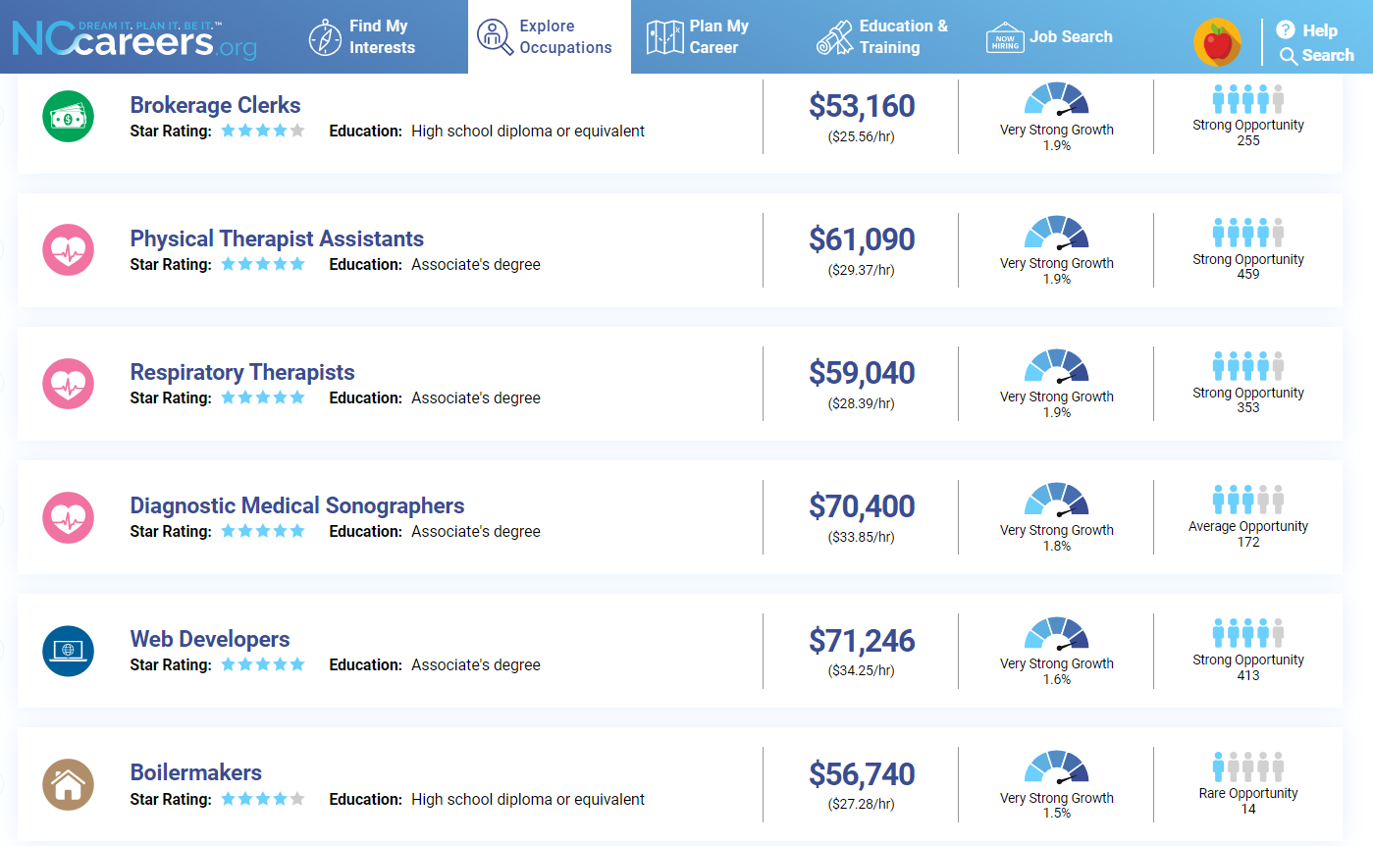
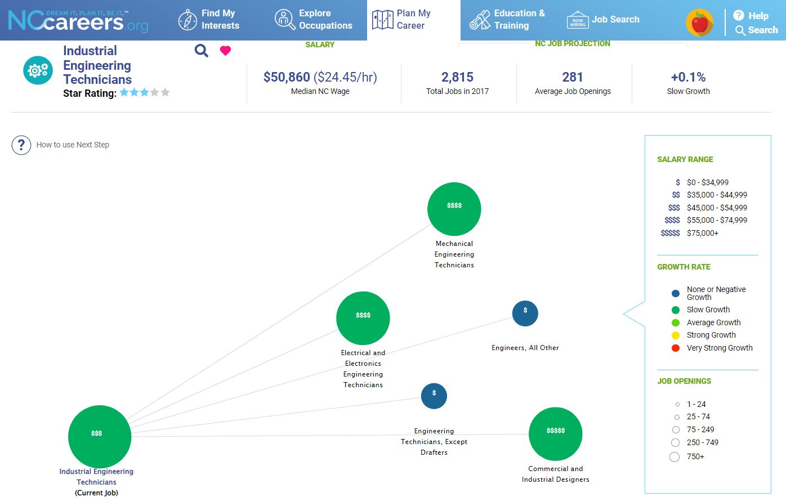
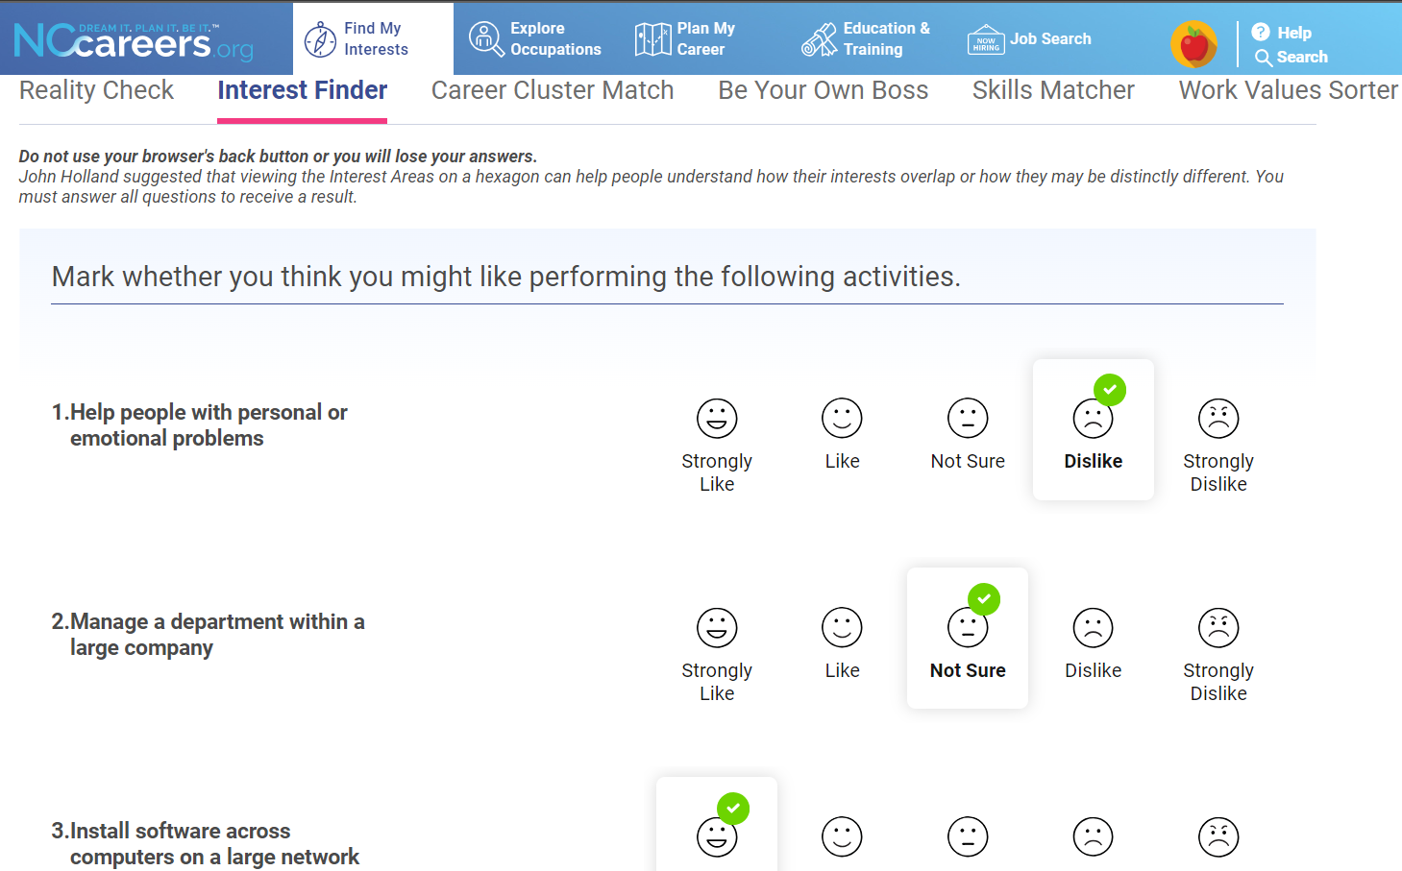
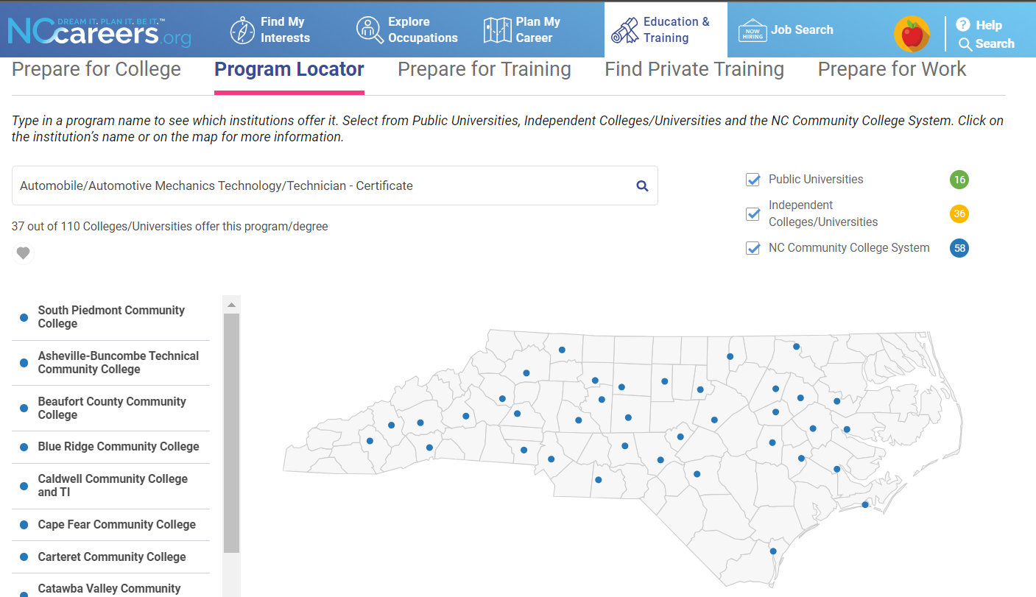

Slide 53
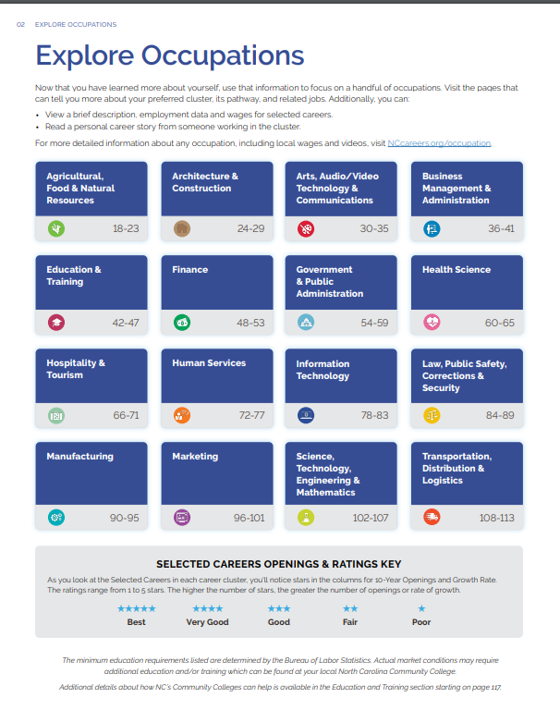
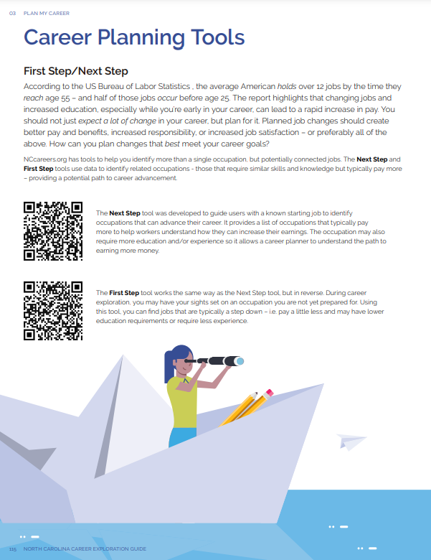

Slide 54
Analytics.NCcommerce.com

Slide 55
Analytics.NCcommerce.com

Slide 56
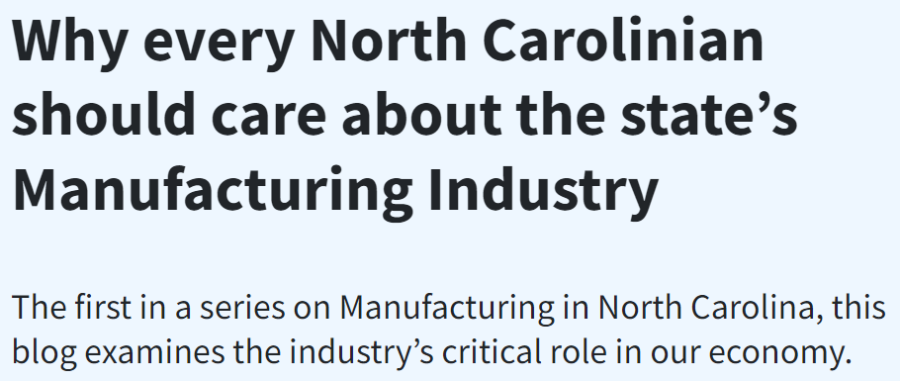
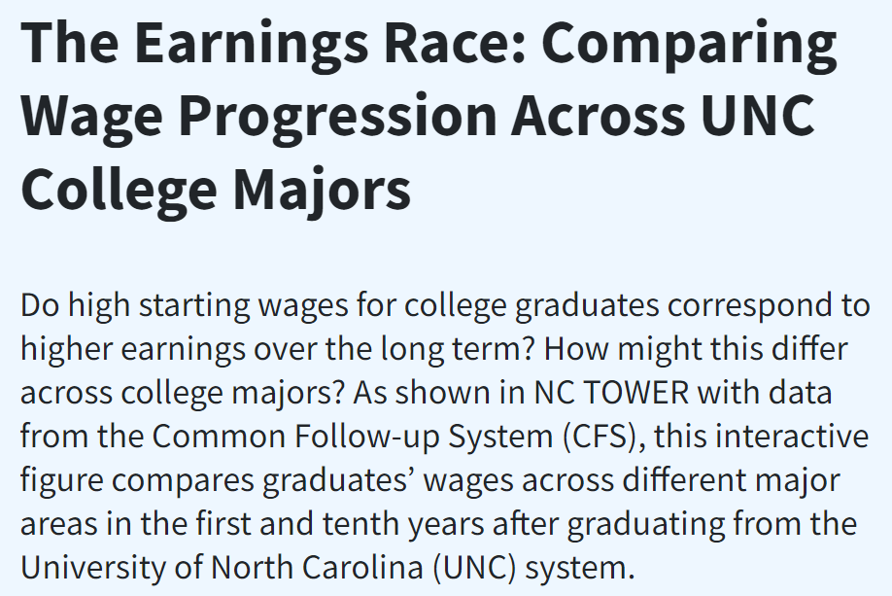
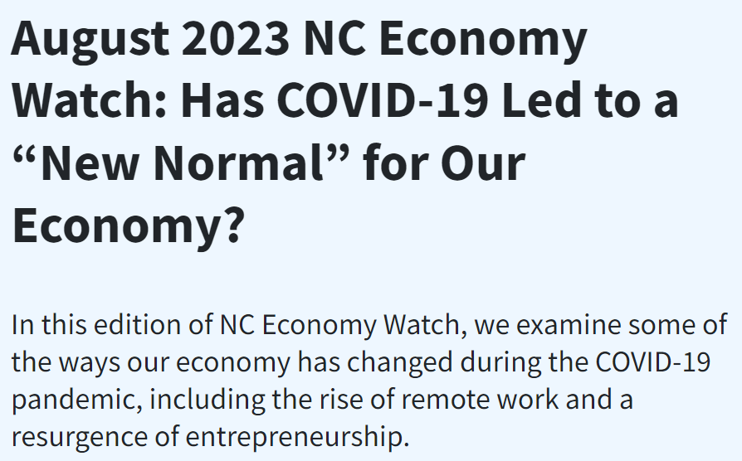
LEAD Feed blog

Slide 57
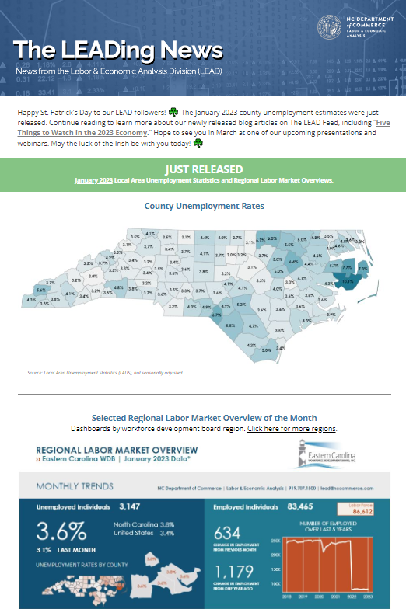
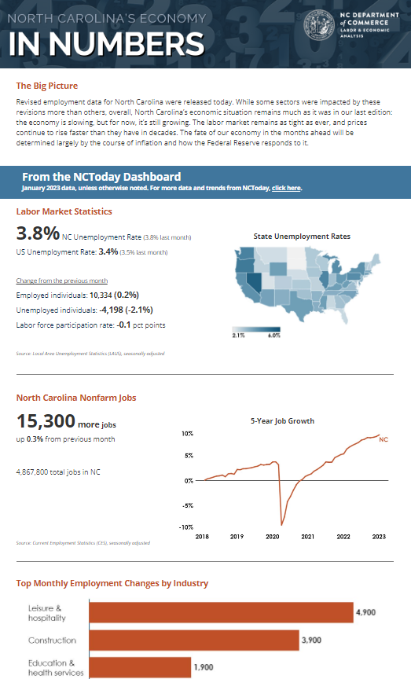
LEAD Feed blog
and Newsletters

Slide 58
Thank you.
Jeff DeBellis
jeff.debellis@ commerce.nc.gov
Follow us on Twitter…
@LeadNC
@CareersInNC

