Slide 1

A Comprehensive Approach to Improving NC Teacher Compensation
January 27, 2016
June St. Clair Atkinson State Superintendent of Public Instruction

Slide 2
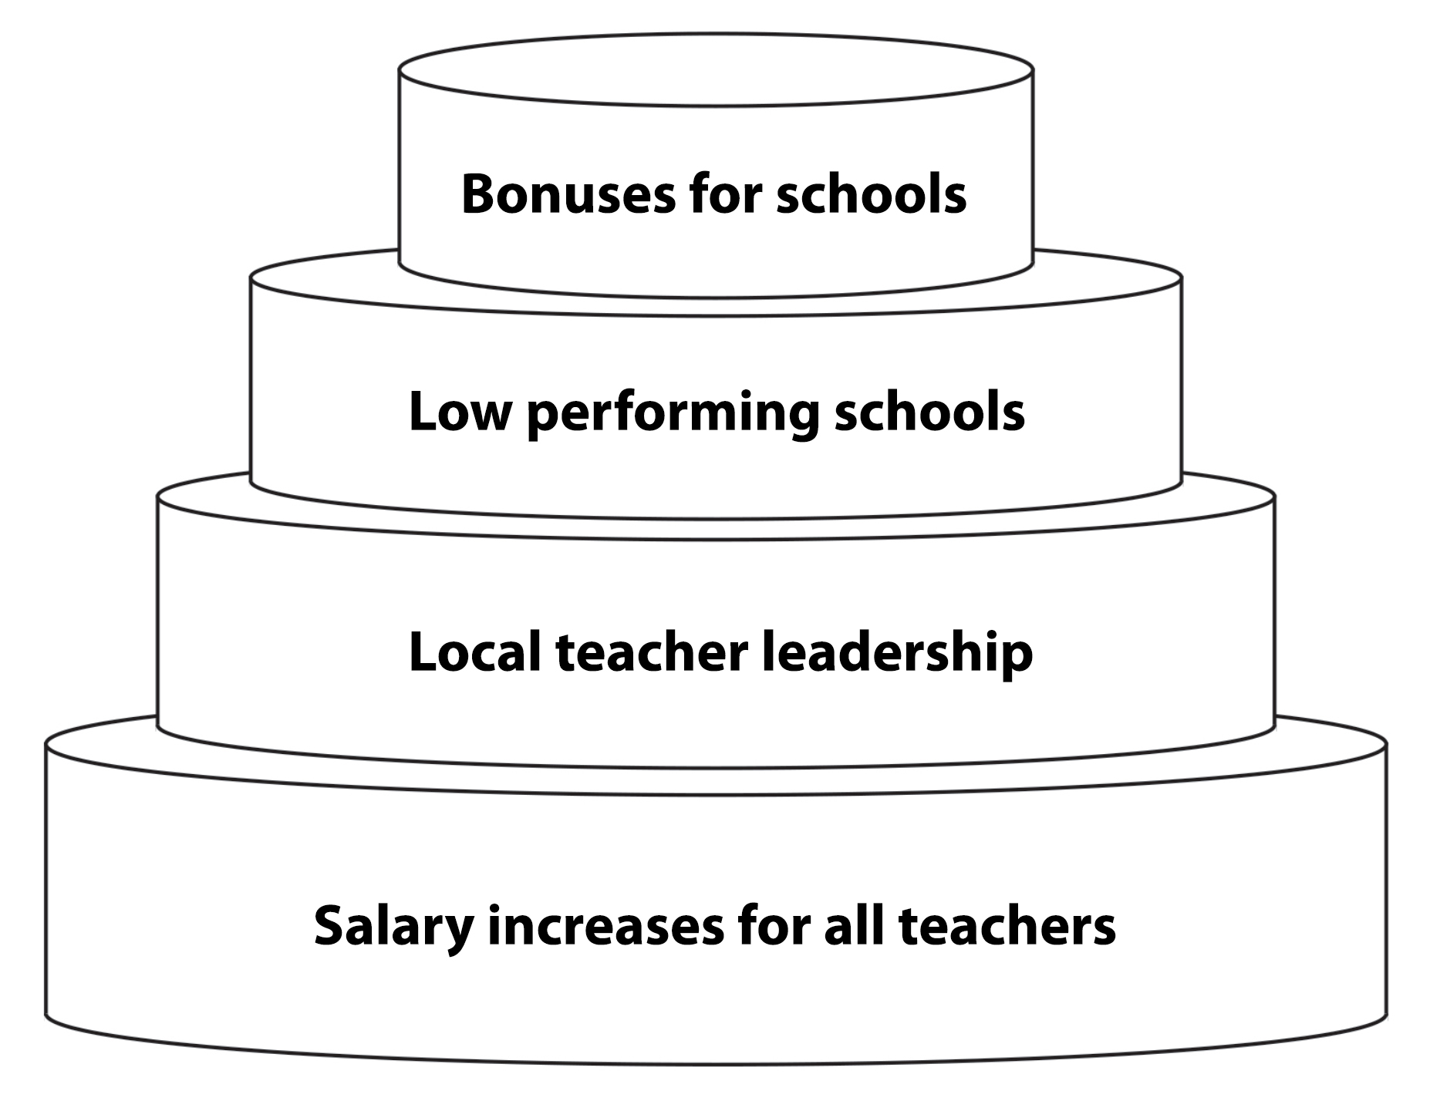
A Comprehensive Approach to Improving NC Teacher Compensation

