Slide 1
Teacher Compensation and Strategic Staffing:
Lessons from Race to the Top
House Select Committee on Education Strategy and Practices
January 27, 2016
Trip Stallings
Director of Policy Research
The Friday Institute for Educational Innovation, NCSU
Based on the NC Race to the Top evaluation work of
The Consortium for Educational Research and Evaluation–North Carolina
http://cerenc.org

Slide 2
Overview
  I. Compensation Options
  Lessons from Race to the Top:
  II. Pay-for-Performance (Incentive-Only)
  III. Strategic Staffing (Differentiated Pay)
    State Strategic Staffing
    Local Strategic Staffing
  IV. Summary and Recommendations

Slide 3
I. Compensation
C

Slide 4
Compensation
C
  Three General Areas for Action:
    Base Pay
    Incentive Pay (including Pay-for-Performance)
    Differentiated Pay

Slide 5
II. Pay-for-Performance
P4P

Slide 6
RttT Pay-for-Performance Incentive
P4P
  Eligibility: Lowest 5% of schools (118 eligible schools)
2011 and 2012: $1,500 school-wide incentive for making “high growth”
  2011: 23 bonus winners
  2012: 35 bonus winners (but only 8 repeats from 2011)
2013 and 2014: $1,500 school-wide, plus additional $500 individual bonus for some teachers (based on individual value-added)
http://cerenc.org/wp-content/uploads/2011/10/FINAL-Bonus-Incentive-Program-Report-8-29-13.pdf

Slide 7
RttT P4P: Impact
P4P
  Little evidence of impact on student performance
  Most teachers—whether awarded or not—said incentives would not change their teaching behavior or practices:
      “[Incentives] are not going to change anything about the way I teach. . . . I may make better records if that’s what’s required, [but] it’s not going to really change anything. We don’t teach to get extra money. It’s not why we do it.”
  More teachers support school-wide (75%) rather than classroom-level bonuses (25%)
  Most are looking for across-the-board salary increases ahead of performance-based incentives:
      “[Current teacher pay] is disrespectful. . . . [V]alue is not given to what we do.”
http://cerenc.org/wp-content/uploads/2011/10/FINAL-Bonus-Incentive-Program-Report-8-29-13.pdf

Slide 8
Other Recent Pay-for-Performance Studies
P4P
  In other states:
  Little consistent evidence that traditional P4P-only incentives increase student outcomes
  Whether incentives are individual or team does not appear to make a difference
  Little consistent evidence that teacher behavior changes because of presence of P4P-only incentives
  Incentive amount does not appear to matter: Several programs studied offered large incentives

Slide 9
III. Strategic Staffing
SS

Slide 10
The Strategic Staffing Landscape
SS
Element | Approaches to Operationalization
Focus on High-Need Schools | School identification based on: Measures of student socioeconomic characteristics Size of special needs population Teacher turnover rates NC ABCs Performance Composites and other measures of student achievement and/or growth Judicial mandate
Focus on Differ-entiation of Educator Effectiveness | Differentiation based on: Student performance and/or growth (via value-added modeling or some other method) Formal and informal educator evaluations Voluntary participation in optional school programs Other qual. measures (e.g., evidence of leadership, results of mandatory re-application for positions, etc.)
Incentives in Support of High-Need School and Teacher Differ-entiation Foci | Individual incentives based on: Actions Development of exemplary teaching materials Willingness to move to a within-LEA target school Willingness to take on leadership roles Willingness to take on challenging teaching assignments Performance Student performance and/or growth Educator evaluation results | Other incentives: Grade- and school-wide incentives based on grade-level or school-wide student performance and/or growth (including incentives for non-certified staff) Incentives in support of targeted professional development and additional coursework Recruitment incentives Retention incentives Non-financial incentives (e.g., housing, equipment, etc.)

Slide 11
State Strategic Staffing Efforts (RttT)
SSS
  Incentive: Annual $5,360 voucher for tuition, housing, loan repayments for qualified teachers who moved to identified schools
  Eligibility: 10 districts and 30 schools with low graduation rates and low performance history
  Scope: Anticipated 181 participating teachers; however, only six teachers qualified in 2011-12, and six more in 2012-13
  By Spring 2013, two teachers had left their schools
  No teacher reported transferring due to the incentive
http://cerenc.org/wp-content/uploads/2011/10/FINAL-State-Strategic-Staffing-8-29-13.pdf

Slide 12
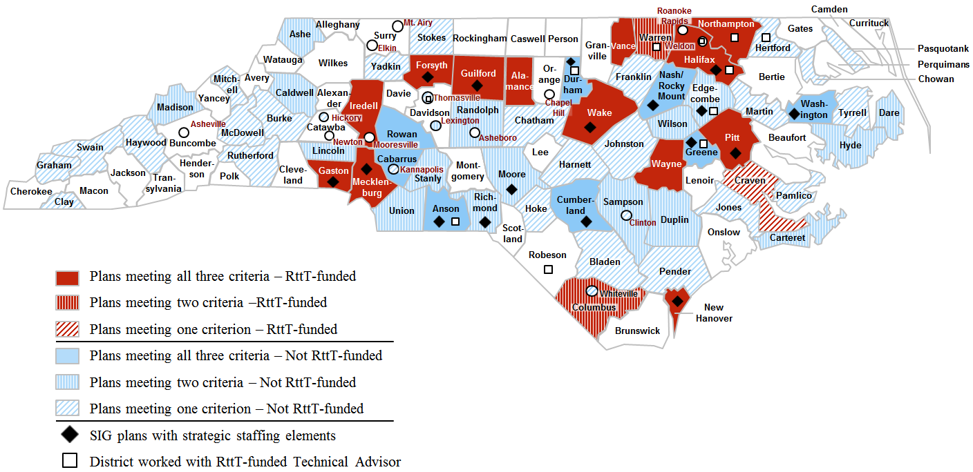
Recent Local Strategic Staffing Plans in NC
LSS
Over $76M invested between 2010 and 2014

Slide 13
Example of a Strategic Staffing Plan (Wayne Co.)
LSS
The Plan:
  Individual- and school-level incentives for retention, prof. devel., and/or classroom- and school-level student performance
Focus on High-Need Schools/Populations:
  Available at one hard-to-staff, underperforming middle school
Differentiation of Teacher Effectiveness:
  Individual incentives for teachers who demonstrated exceptional student growth (via EVAAS estimates and/or teacher eval. data)
Incentives:
  7 days additional pay for 40+ hours of professional development
  Recruitment/retention pay for new/returning teachers
  Mix of school-wide and individual-level performance incentives
  Total incentive pay up to $4,500 (teachers), $2,750 (classified staff)

Slide 14
IV. Summary and Recommendations
S&R

Slide 15
Summary
S&R
  The Past Should Guide the Future: The state has experimented with many alternative pay plans over the years
  P4P Alone Is Not Enough:
    There is no consistent evidence that performance incentives alone have a meaningful, sustained impact on recruitment, retention, or student performance
    Teachers report that they are not motivated by performance incentives in isolation
  Districts Can Lead the Way on Strategic Staffing: Many districts have designed and administered local-context strategic staffing plans—but few have been rigorously evaluated

Slide 16
Recommendations
S&R
  Continue to fund across-the-board salary increases to approach regional parity & stem salary-based attrition
  Fund multiple strategic staffing differentiated pay pilots that build on past state and local efforts
    Pilot scope: At least 3 years in 6 to 8 representative districts (urban/rural; low-weath/higher-wealth; Mountain/Piedmont/Coastal)
    Require fully-realized strategic staffing differentiated pay plans, not incentive-only plans; prioritize existing plans with defensible track records
    Support robust evaluations of the pilots
    Prioritize within-district staffing outcomes (redistribution, retention, school climate) over recruitment or student achievement outcomes
    Commit to scaling up statewide the best of these options after the third year
    Allow districts to choose among “winning” options
  Plan for sustainability

