Slide 1
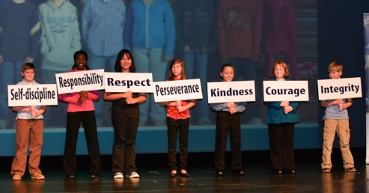
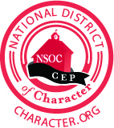
Transforming a school district through character Development
Charlos Banks, Executive Director for Student Services and Character Development
Yvonne Foster, Coordinator for Character Development and Service-Learning
Notes:
CHARLOS: Good Morning, I am Charlos Banks and I currently serve as the executive director of student services and character development. Prior to assuming this position, I have served as principal, district office administrator, school counselor, and teacher all within Guilford County Schools. I have had the opportunity over my twenty year tenure with the district to see and actually be a part of the ongoing transformation of us forming a National District of Character. It has been an exciting experience and one that as we share with you our journey to this point, it is our hope you are able to understand how our program has made a positive impact on our students and the GCS community as a whole.
I would like to take this opportunity to also introduce someone who has been very instrumental in leading the work for our district, Ms. Yvonne Foster, coordinator for Character Development. Together she and I hope to accomplish the following as a result of this presentation:
-Give you a snapshot of who we are as district
-Articulate our district’s vision for Character Development – along with goals, strategies, and action steps taken to establish our program
- And last but most important help you understand how Character Development has made such a significant impact on the learning opportunities for our students.

Slide 2
GCS Diversity
Student Demographics 2014-2015
5.81%
35.19%
41%
3.83%
13.46%
72,191 students (20th day enrollment)
*does not include pre-K
Notes:
Charlos:
Here’s what GCS looks like for grades K through 12 using our 20th day of school student enrollment from this school year. As you can see, we are a pretty diverse school district
Our student body is about: 41% black, 35% white, 13% Hispanic, 6% Asian, 4% multiracial, and less than 1 % American Indian/Pacific Islander.

Slide 3
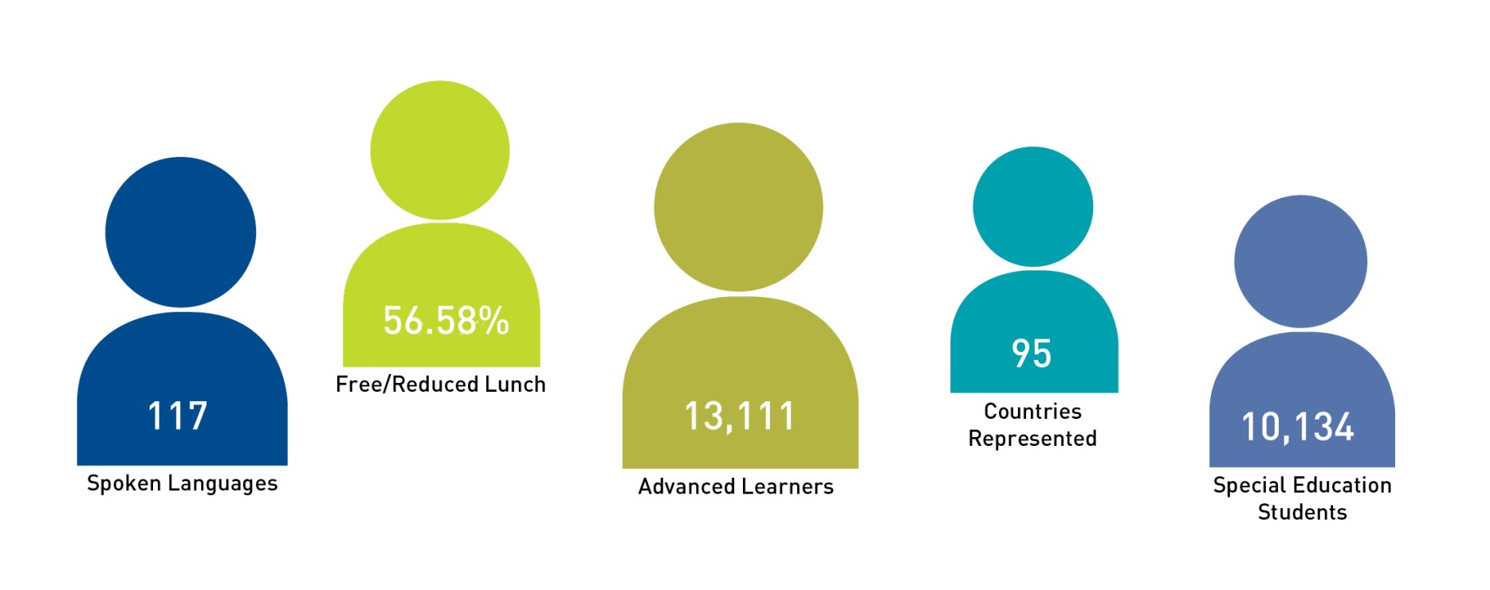
GCS Diversity
Student Demographics 2014-2015
59.41%
79
128
13,441
10,542
Notes:
CHARLOS: Our students, who hail from 79 countries and speak about 128 different languages, represent everything that is right and good about our community and about our nation.
In GCS, we see diversity as an opportunity for rich learning opportunities and the daily practice of democracy. As a result, our children leave our schools better prepared to lead and compete in the global economy.
Approximately 59.41 percent of our students qualify for free or reduced price lunch And we recently learned that 67% of students currently enrolled in Guilford County Schools (GCS) are considered low-income – which means more than 1 out of every 2 student may not have enough to eat at home.
We also serve large numbers of students who are gifted and talented – more than 13,000 and large numbers of students who receive special education services -- more than 10,000.

Slide 4
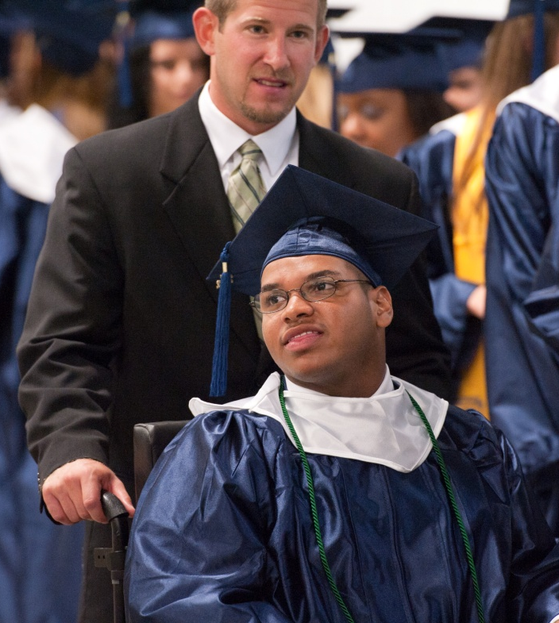
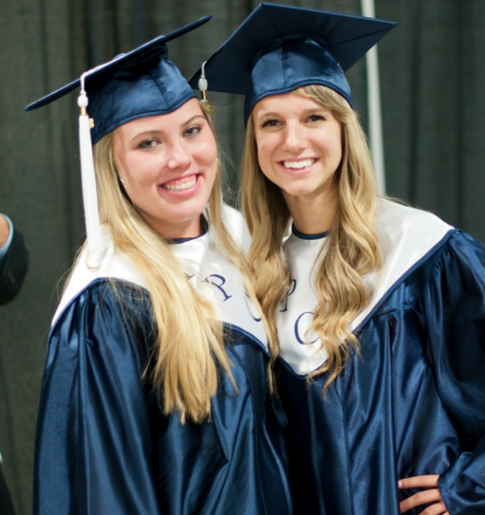
Our vision: achieving educational excellence
Notes:
CHARLOS: To understand where Guilford County Schools is today, we must look back. When our superintendent arrived in 2008, he conducted a listening and learning tour called “Mo Wants to Know.” The responses to this tour would help us develop the district’s first strategic plan.
He heard over and over again from parents, our community and school staff that there was something missing from the education that we are not providing for our students.
Two common themes emerged – the desire to improve academic outcomes and student behavior.
So our vision in Guilford County Schools can be summed up in two words “educational excellence” – and we define educational excellence as encompassing three key ideals: 1) academic excellence; 2) excellence in character development, citizenship, and service learning; and, 3) excellence in operations and all things. Everything we do in GCS, we start by asking: What does excellence look like? Once we dream it, we set out to achieve it. And that means we have to execute well, each and every day.
Our first strategic plan, “Achieving Educational Excellence,” was launched in January of 2009 and concluded at the end of the 2012 calendar year. In that plan, we identified measurable goals – our report card to the community if you will – and developed strategies to help us achieve those goals.
Our budget, our plans, our projects, and every initiative, mapped back to the vision of the strategic plan and to those goals – thus achieving academic excellence for all students

Slide 5
Guilford County schools proud!
GCS Proud!
Highest Graduation Rate
2013 Eight schools, including six large traditional high schools, had graduation rates between 90 and 99%
2014 Seven schools achieved a 100% graduation rate
2014 Fourteen schools, including ten large traditional high schools, had graduation rates between 90 and 99% (highest in N.C.)
Graduation Year | Graduation Rate
2012 | 84.5%
2013 | 86.2%
2014 | 88.5%
Notes:
CHARLOS: Since of the launch of the first strategic plan, we experienced a tremendous amount of success in our school district.
For example, in just one day in May 2013, GCS celebrated three achievements – a State Athlete of the Year, a State Teacher of the Year and a special recognition by the State Board of Education as the State’s District of Character.
GCS celebrated the wonderful news about our graduation rate.
(briefly expand on grad rate)

Slide 6
Guilford county schools proud!
GCS Proud!
2013 – 2018 GCS Recognized as a National District of Character
2013 GCS was one of only three districts in the country to earn the recognition
2013 - 2016 GCS is a North Carolina District of Character
2014 Sixteen GCS programs earned national awards for “Promising Practices“ in character development
2014 Recognized as a District of Distinction by District Administration
2015 Three additional schools named a State School of Character totaling seven schools that carry this recognition
Notes:
CHARLOS:
Also in May, GCS learned it was a 2013 National District of Character – one of only three districts in the country to earn the recognition. This award really recognizes the commitment of our educators, administrators, students and community members.
In addition in 2013 , nine schools received the Character Education Partnership's Promising Practice Award, which showcases innovative best practices in character education and in 2014, 16 GCS programs earned a Promising Practice Award and 4 schools were recognized as State Schools of Character and 3 of them successfully obtained the National School of Character recognition.

Slide 7
Discipline data trends
GCS Trends with Student Discipline
Highlights
The number of OSS offenses have decreased 24.2% since the 2007-08 school year.
93.3% of GCS students did not receive an out-of-school suspension (OSS) in 2012-13.
Notes:
CHARLOS: Since the start of our Character Development Initiative we have also recognized a decrease in student discipline as it relates to OSS offenses. Of course, we can not solely contribute this decline to implementing a strong CD program however we do believe this has played a role in encouraging positive behaviors within students and restorative practices for consequences as it relates to negative behaviors.

Slide 8
Character Development Vision
“Intelligence plus character – that is the goal of true education.”
- Dr. Martin Luther King, Jr.
Notes:
YVONNE: Character development and service-learning were reflected heavily in the district’s first strategic plan.
With Dr. King, we believe “Intelligence plus character – that is goal of true education.”
(Educating students to not only be successful personally, but to be active contributors as part of a community, to put their learning and skills to a public purpose.) Character Development is very much an integral part of how we educate our students and we have found that our students in response have embraced these learning opportunities and used them as vehicles to develop strong leadership skills and to create a powerful youth voice in addressing local, state, and global issues that plague our society.

Slide 9
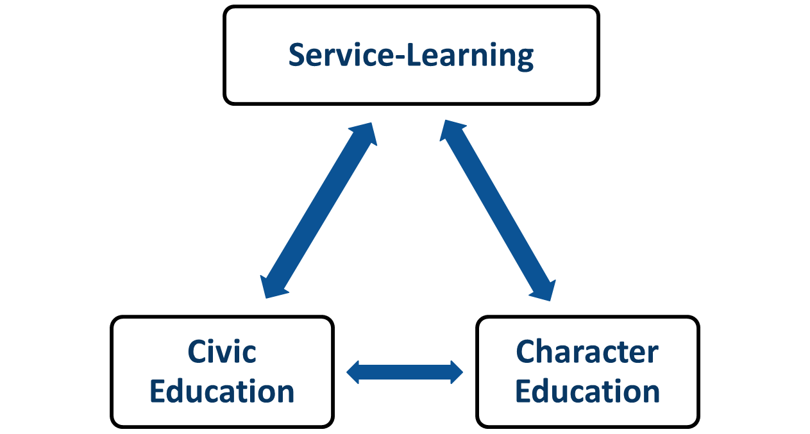
Character Development Plan
Fundamentals of Character Development
Notes:
YVONNE: So in providing our students a holistic education, we identified the three fundamental elements of GCS’ Character Development Initiative which are character education, civic education, and service learning.
- Character Education is the deliberate effort to help people understand, care about and act upon core ethical values.
- Civic Education consists of both a core curriculum and teaching strategies that give students the knowledge, skills, virtues and confidence to actively participate in democratic life.
- The service-learning component connects meaningful community service experiences with academic learning, personal growth, and civic responsibility.
Service-learning is very instrumental in driving our program, it helps youth demonstrate the other two areas, civic education and character education -
Providing a complete education – of intelligence and of character. Our students have engaged in many service-learning opportunities across the district, state, and abroad. We would like to take this moment to share just a few those experiences with you – Play clips

Slide 10
Examples of Service learning
Notes:
Yvonne - Embedded videos of service-learning opportunities – Dudley High School, Penn Griffin, and Archer Elementary.
As you can see our students are engaged in acts of service from elementary school through high school. We are extremely proud of their efforts in applying their knowledge and skills to address problems of local, national and global importance. Our students have indicated that service-learning not only provides them with an opportunity to make a difference in our society but for many of them it is their first opportunity of achieving and being recognized as a leader among their peers.

Slide 11
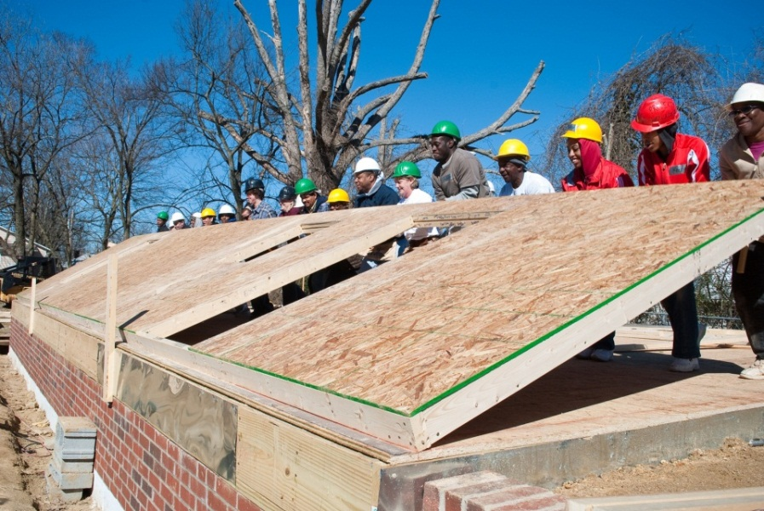
Leading the Way
Leading the Way in Character
Starting from the Top
A new policy adopted by the Guilford County Board of Education established character development as a part of the education students receive in GCS.
Community Kickoff
GCS leaders, students, teachers
and community members came together to build a house through Habitat for Humanity -- building a foundation for character and service.
Notes:
YVONNE: One of the contributing factors to our success with character development is because we started from the top in building the support and emphasis of importance that this initiative would have on the educational experience for GCS students. Our school board adopted a new policy establish character develop as a part of the education for all students and in January of 2010 ,we formally launched this initiative during our State of Our Schools’ event, and announced our first district-wide service-learning project, which helped raise awareness of the initiative and helped how service can build character.
Through our generous community, our district’s students and staff were able to work together to build a house through Habitat for Humanity. During those 20 Saturdays, we did more than build a house; we built a foundation for character education and service-learning.
Since then, our students and staff have embraced the concepts, and it is having a positive impact on academics, student behavior and school culture.

Slide 12
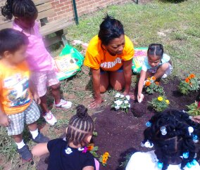
Leading the Way
Leading the Way in Character
Summer of 2014 Principals and District Leaders Give Back to Community
One Day of Service expands to Summer of Service
Principals and district leaders volunteer with more than 15 organizations across the county
During 24 days of the Summer
Providing more than 1000 hours of service to our community
Notes:
YVONNE: We felt it was important in the beginning of this initiative to model our expectation to youth and so staff, district and school leaders joined together to serve more than one community organization and expanded to one day of service serving over 15 organization across the county.
In the summer of 2011, we expanded this concept even more from one day of service to a summer of service. This has become a traditional practice for the past three summers in which we have received wonderful feedback from the community and school leaders, and so in moving forward we hope to continue to replicate this experience in hopes of expanding to a year of service.

Slide 13
Integrating Character
Integrating Character District-Wide
Character Development Initiative Deployment Plan & Team
Staff Realignment & Board of Education Funding
Character Development School-Level Audit
School Improvement Plans
Professional Development
Service-Learning Ambassadors
Community Partnerships
Formal and Informal Curriculum Connections
Notes:
YVONNE: Here is a list of additional practices and strategies we used to integrate character development all which have play equal roles in helping us sustain a successful program. We have attribute a lot the work to our youth who serves as Service-Learning Ambassadors across all high schools who really led this work in terms of increasing youth involvement and raising the level of importance in our schools and within our community.
(WE WILL NOT ELABORATE HERE UNLESS ASKED FOR ADDITIONAL DETAILS WHICH ARE LISTED BELOW)
The character development team put together a deployment plan that included 31 deliverables to help the district meet those 2012 SP goals. One of the biggest of these deliverables was developing curriculum that was aligned to the N.C. Course of Study.
Staff realignment – A Character Development department was developed when funding for the Safe Schools and Drug Free was going away – so we were able to utilize these same administrators and make them character development coaches. The focus then moved from intervention and prevention to asset development - how do we build our students’ competencies and how do we build the characteristics they already have?
Our character development team coordinated a school-level audit in which they surveyed each school improvement team to assess what they were already doing to address character development, what were their needs, what was their understanding of the initiative, and what type of professional development they needed.
GCS added a component to the school improvement plan where schools had to set goals for character development – they would measure this by climate surveys – student/staff perception, safety and school engagement.
Professional development was given to teacher leaders thanks in part to the National Youth Leadership Council.
An aspect of this initiative that has really let our students take the lead has been the addition of service-learning ambassadors. These ambassadors are high school students who are trained each fall, and as of this year, we have about 400 student ambassadors. Their main responsibilities include leading service-learning projects and assisting students in tracking their hours through Noble Hour, an online tracking system.
National Youth Leadership Council has also helped train our service-learning ambassadors, and students have presented at their annual conference and hosted workshops.
In this process, we found it very important to connect with many of our community partners who provided youth an opportunity to support their organizations through service-learning.
The team developed a lesson plan on every grade level that was aligned to the standard course of study and training was provided to teachers and counselors. Schools supported this work by encouraging teachers to use service-learning as an engaging instructional strategy across all content areas.
Lastly, when we think about informal curriculum it speaks to our expectations of student behavior. As a district, we started looking at how do we integrate this practices within our athletic programs, after school programs for elementary students and all aspects of student services.

Slide 14
GCS character development tiered support model
Sustaining Character Development
District-Wide
GCS Character Development & Service-Learning Tiered Support Model The GCS Character Development Department has established multi-tiered levels of support for our K-12 schools across the district. The tiered levels of support were determined based on the school’s 2013-2014 current state as measured by the 11 Principles of Effective Character Education (Four Descriptors) and for high schools, the percentage of graduating seniors who are recognized with a Service-Learning Diploma or Exemplary Award. This tiered model will be used to inform our work with schools, by providing personalized support based on school plans. Character Development Coaches will collaborate with teams selected by school principals to identify support offered from the menu of services.
Notes:
Yvonne: So as we move forward we are looking into ways to ensure all of our schools are providing optimal character development practices for all students. This year we have introduced our tiered support model which outlines how our department provides prescriptive support to all schools. This model is developed to help us better support schools in how they define their character development program, demonstrate what it looks like within their instructional practices and how they provide continuous assessment of successful implementation and positive impact on student achievement. One of the most effective ways we have assessed our practices is through the State and National District of Character application process. This process requires you to reflect on your effectiveness in implementing the 11 principles of effective character education. We aspire to one day celebrate all of our schools as National Schools of Character and are certainly working on this achievement every day.

Slide 15
Celebrating Success
Cool to Serve
Event recognizes and rewards students’ commitment to service- learning, thanks to the generosity of the local business community.
480 members of the Class of 2014 earned a service-learning diploma for completing at least 250 hours of service in high school. Another 441 earned the exemplary award for completing 100 hours.
GCS High School Students have documented more than 1 million hours of service-learning since 2011.
More than 160 community organization have partnered with the district through the High School Service-Learning Initiative.
Celebrating Success
Notes:
YVONNE:
In GCS, we love celebrating the success of our students as they engage in the work of character development and one way we celebrating their success is through our Cool to Serve Event.
In 2012, GCS held an annual event called Cool to Serve, which recognizes and rewards recent graduates for their commitment to service learning. Students who earn the district’s service-learning diploma or service-learning exemplary award are invited to attend, but only those who earn the diploma are eligible to win a brand new car – all of which is sponsored by the generosity of our business community.
In 2011-12, high school students completed 164,606 hours of service and to date our students have documented over 1 million service-learning hours serving more than 160 community partners which equates to an economic impact of $21 million. (based on NC volunteer rate as of 2013 = $21.04)

Slide 16
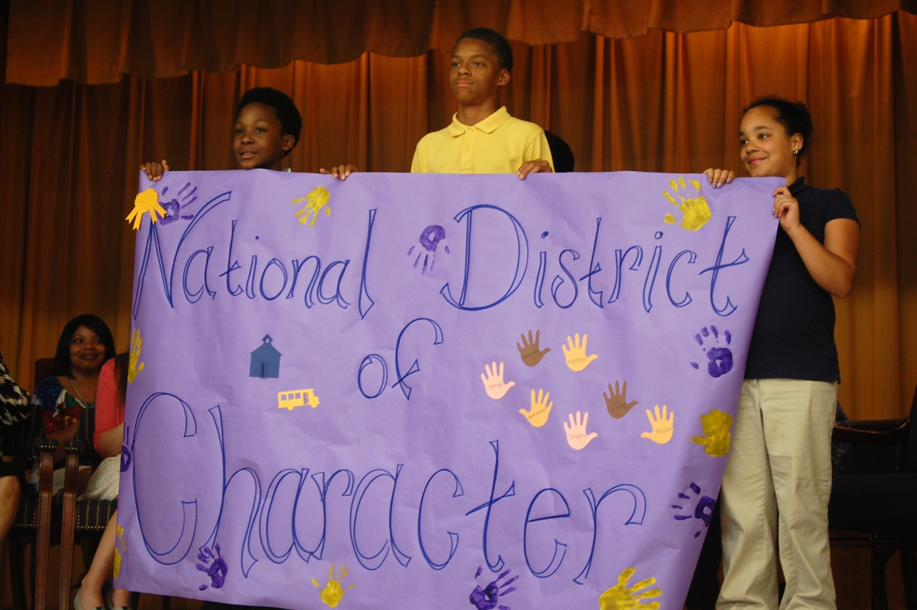
Celebrating Success
Celebrating Success
GCS Recognized as National Leader in Character
Notes:
CHARLOS: Building a National District of Character has been an extraordinary journey for our district as a whole. We are thankful that we have a community of supporters from our superintendent, school board members all the way down to our parents and mostly important our students who are leaders behind the work. Charlos – We would like to close with one last video clip of our students you saw in the previous video advocating for the need for more bus benches within their community. As a result of their ongoing efforts, they were able to raise funding and actually build one of the many benches they hope to increase across our district. This group of students in partnership with one of our local college – UNCG took this initiative from service-learning to an act of creating social justice. They started this initiative in 2007 and are still working with their teachers, community leaders, county commissioners, university professors and most importantly their peers to advocate effectively for a positive change in their community.

Slide 17
UNCG, Dudley High students team up for ‘Bring Us Benches and Bus Shelters’ project
The Bring Us Benches and Bus Shelters project arose out of the need for more bus shelters and benches in Greensboro. UNCG students worked with students at Dudley High to advocate for more bus shelters and other social issues.
Dudley students collected umbrellas for homeless shelters, and lobbied the Greensboro City Council for more bus shelters.
The goal of the project was to increase retention at Dudley by helping students become more engaged in civic issues they care about.
Fox 8 News

Slide 18
Transforming a school district through character Development
“It’s not our job to toughen our children to face a cruel and heartless world. It’s our job to raise children who will make the world less cruel and heartless.” L.R. Knost
www.gcsnc.com
Email: servicelearning@gcsnc.com
Phone: (336) 370-8397
Notes:
CHARLOS: Thank you so much for allowing us to share our journey with you. We are so proud of our school community and their work in transforming our district into a National District of Character. This work has been a collaborative effort on the part of our school leaders, parents, students, and the community. We are certainly excited about what’s ahead, and look forward to building on our successes to create a longstanding program which supports achieving academic excellence for all students.

